Slide 1

Note: The data and information in this document is reflective of a hypothetical situation and client. This document is to be used for KPMG Virtual Internship purposes only.
Sprocket Central Pty Ltd
Data analytics approach
[KPMG] - [Engagement Manager], [Senior Consultant], [Kumar Siddharth]

Slide 2
Note: The data and information in this document is reflective of a hypothetical situation and client. This document is to be used for KPMG Virtual Internship purposes only.
Agenda
Introduction
Data Exploration
Model Development
Interpretation

Slide 3
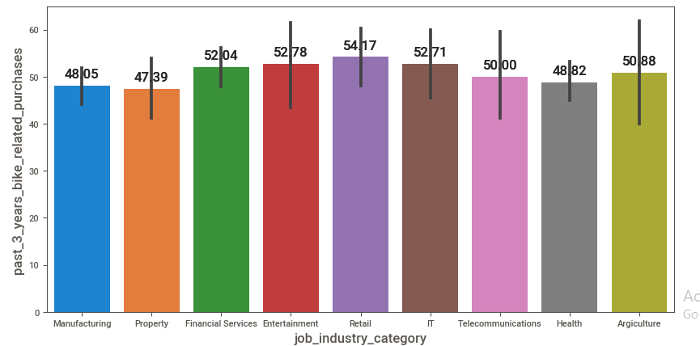
Note: The data and information in this document is reflective of a hypothetical situation and client. This document is to be used for KPMG Virtual Internship purposes only.
Introduction
Customer Purchasing Pattern
The Top 6 industry of customer for
targeted sale.
1)Agriculture
2)Telecommunication
3)IT
4)Entertainment
5)Financial service
6)Retail

Slide 4
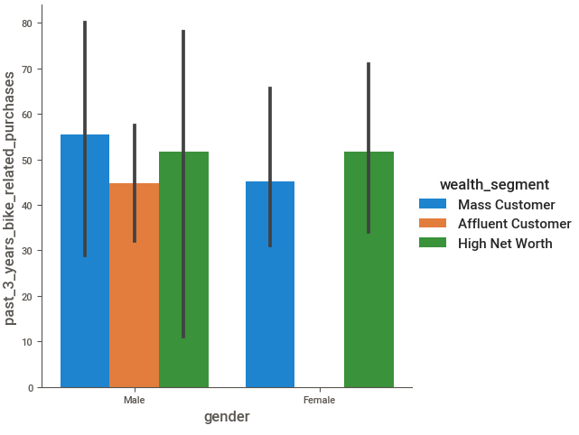
Note: The data and information in this document is reflective of a hypothetical situation and client. This document is to be used for KPMG Virtual Internship purposes only.
Data Exploration
Exploring each industry with respect to gender and wealth segment
Agriculture
1)male as mass customer and
High net worth are likely to buy
From company
2)females with high net worth are
Likely to buy from company

Slide 5
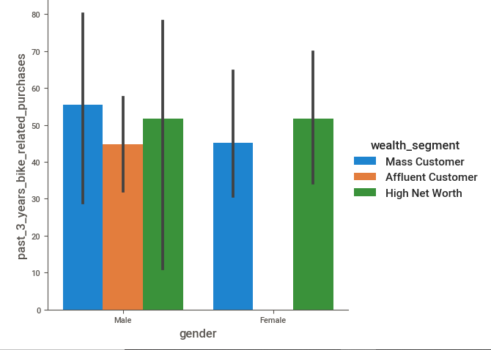
Note: The data and information in this document is reflective of a hypothetical situation and client. This document is to be used for KPMG Virtual Internship purposes only.
Data Exploration
Exploring each industry with respect to gender and wealth segment
Telecommunication
1)male as mass customer and
High net worth are likely to buy
From company
2)females with high net worth are
Likely to buy from company

Slide 6
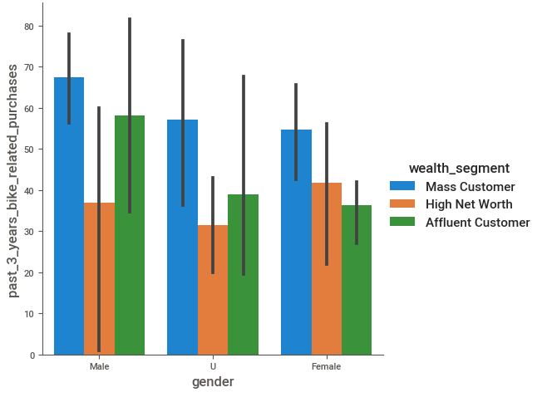
Note: The data and information in this document is reflective of a hypothetical situation and client. This document is to be used for KPMG Virtual Internship purposes only.
Data Exploration
Exploring each industry with respect to gender and wealth segment
IT
1)male as mass customer and
High net worth are likely to buy
From company
2)females with mass customer are
Likely to buy from company

Slide 7
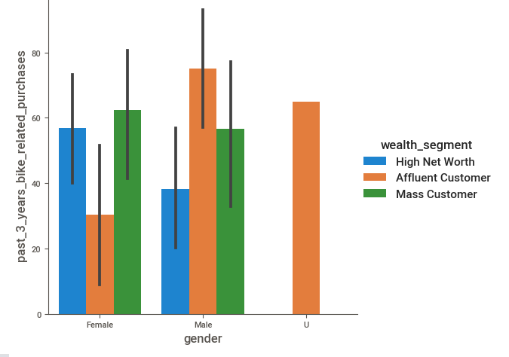
Note: The data and information in this document is reflective of a hypothetical situation and client. This document is to be used for KPMG Virtual Internship purposes only.
Data Exploration
Exploring each industry with respect to gender and wealth segment
Entertainment
1)male as affluent customer
are likely to buy From company
2)females with high net worth and
Mass customer are more
Likely to buy from company

Slide 8
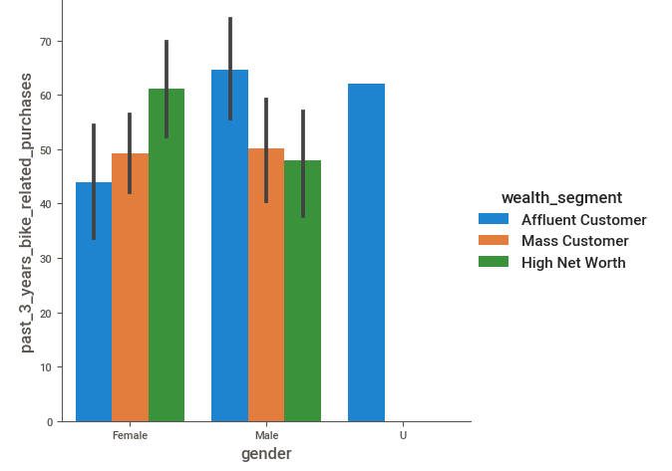
Note: The data and information in this document is reflective of a hypothetical situation and client. This document is to be used for KPMG Virtual Internship purposes only.
Data Exploration
Exploring each industry with respect to gender and wealth segment
Financial service
1)female as mass customer and
High net worth are likely to buy
From company
2)males as affluent customer and
Mass customer are moreLikely to
buy from company

Slide 9
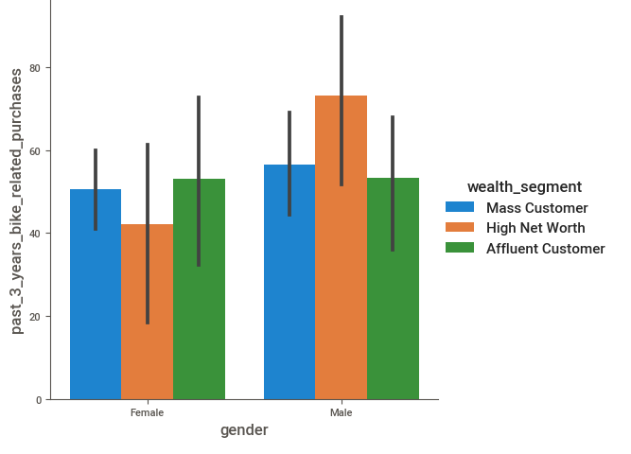
Note: The data and information in this document is reflective of a hypothetical situation and client. This document is to be used for KPMG Virtual Internship purposes only.
Data Exploration
Exploring each industry with respect to gender and wealth segment
Retail
1)female as mass customer and
High net worth are likely to buy
From company
2)males with high net worth and
Mass customer are more
Likely to buy from company

Slide 10
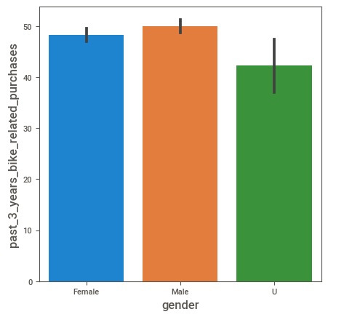
Note: The data and information in this document is reflective of a hypothetical situation and client. This document is to be used for KPMG Virtual Internship purposes only.
Model Development
Comparing gender and wealth segment to determine our target.
Gender
Male are more likely to buy from the company
Place any supporting images, graphs, data or extra text here.

Slide 11
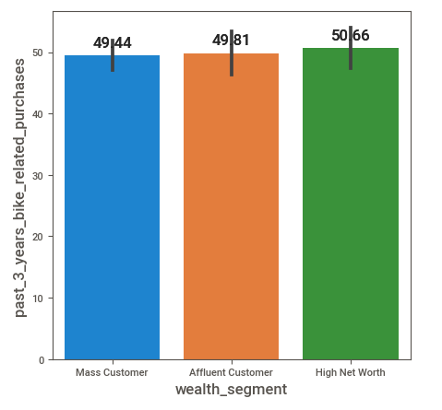
Note: The data and information in this document is reflective of a hypothetical situation and client. This document is to be used for KPMG Virtual Internship purposes only.
Model Development
Comparing gender and wealth segment to determine our target.
Wealth segment
Customers with High net worth are more likely to buy from the company
Place any supporting images, graphs, data or extra text here.

Slide 12
Note: The data and information in this document is reflective of a hypothetical situation and client. This document is to be used for KPMG Virtual Internship purposes only.
Interpretation
Target customer data
Ideal target customer
gender
Female
Wealth
Mass customer and high networth
Industry
1)Agriculture,2)Telecommunication,3)IT
4)Entertainment,5)Financial service
6)Retail
Male purchase accounts for 47.68% of total sale female =52.32%
Mass customers 50.39%
Affluent Customer 24.08%
High Net Worth 25.51

Slide 13
Note: The data and information in this document is reflective of a hypothetical situation and client. This document is to be used for KPMG Virtual Internship purposes only.
Appendix

Slide 14
Note: The data and information in this document is reflective of a hypothetical situation and client. This document is to be used for KPMG Virtual Internship purposes only.
Appendix
This is an optional slide where you may place any supporting items.

